Slide 1

Dream Team Brad, Jorge, Luke, Tyler, Edgar
Chasing the End

Slide 2
Team Lead 4 Presentation Overview
Gantt Chart And Cost
Coding Standards
Test and Game Updates
Game Demo
QA

Slide 3
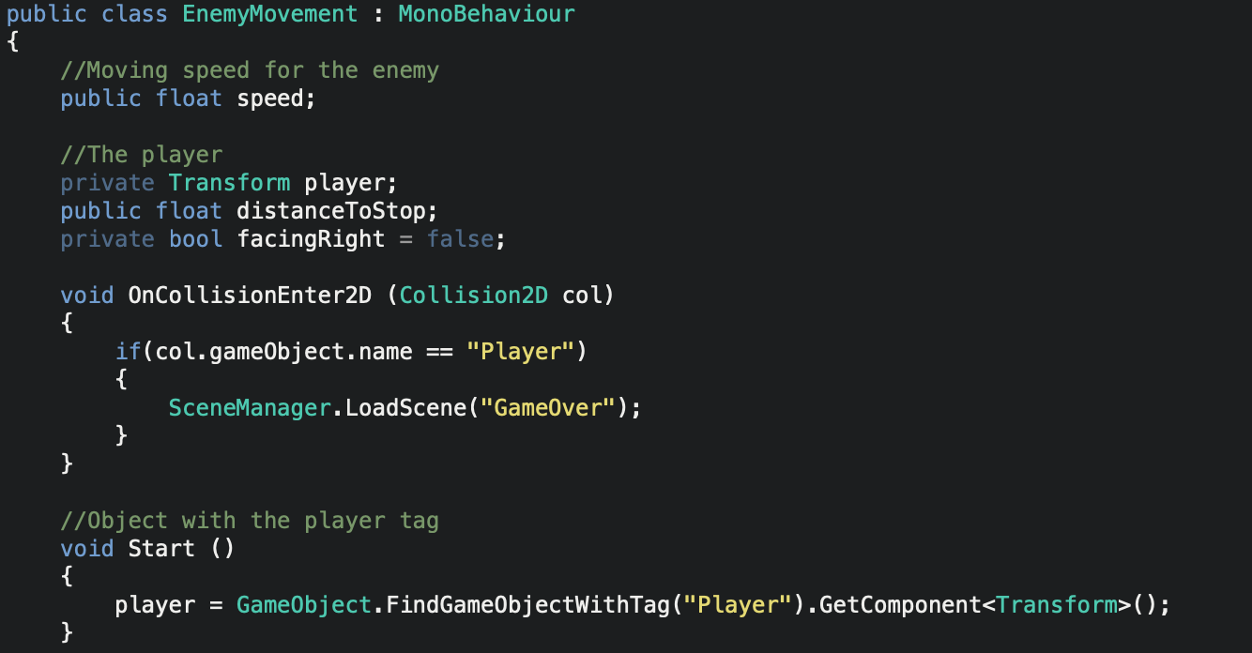
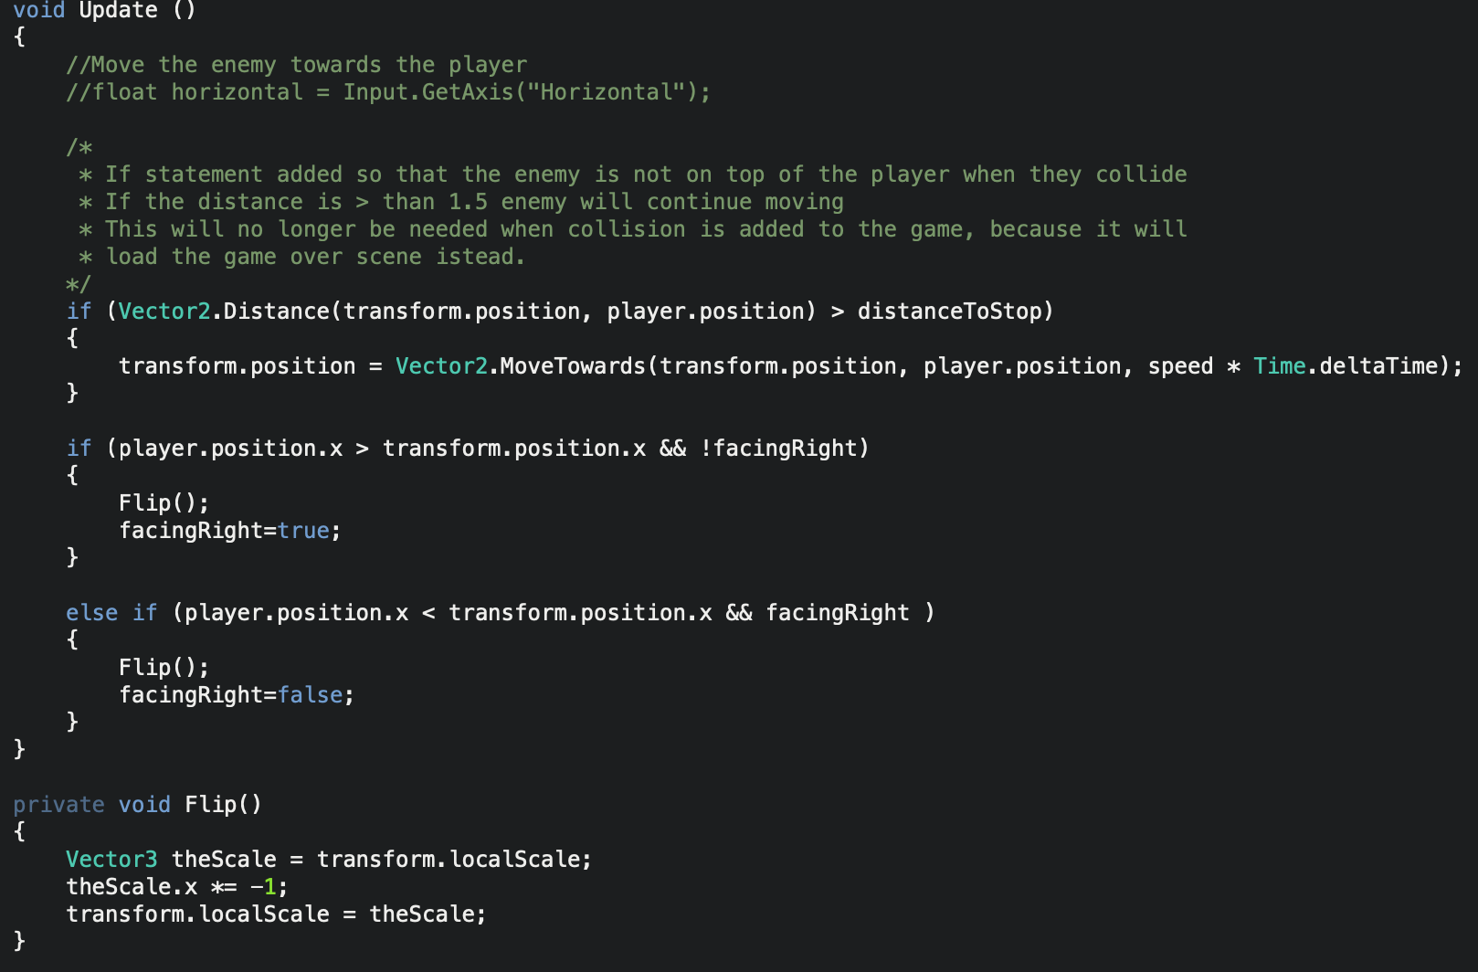
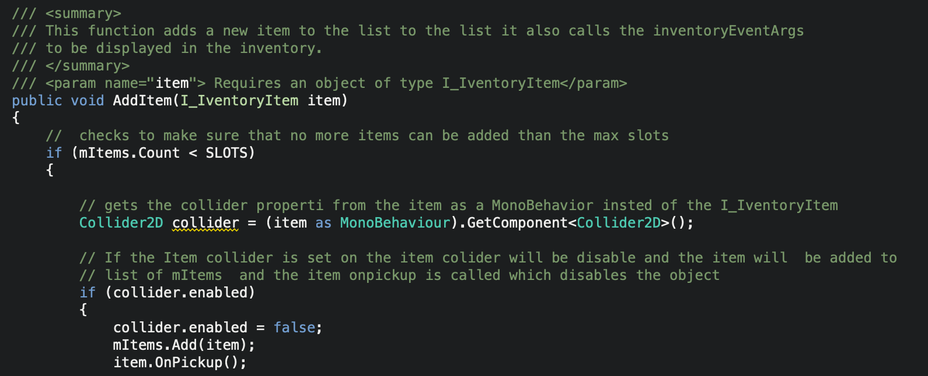
Coding standards
Enemy Movement
Inventory

Slide 4
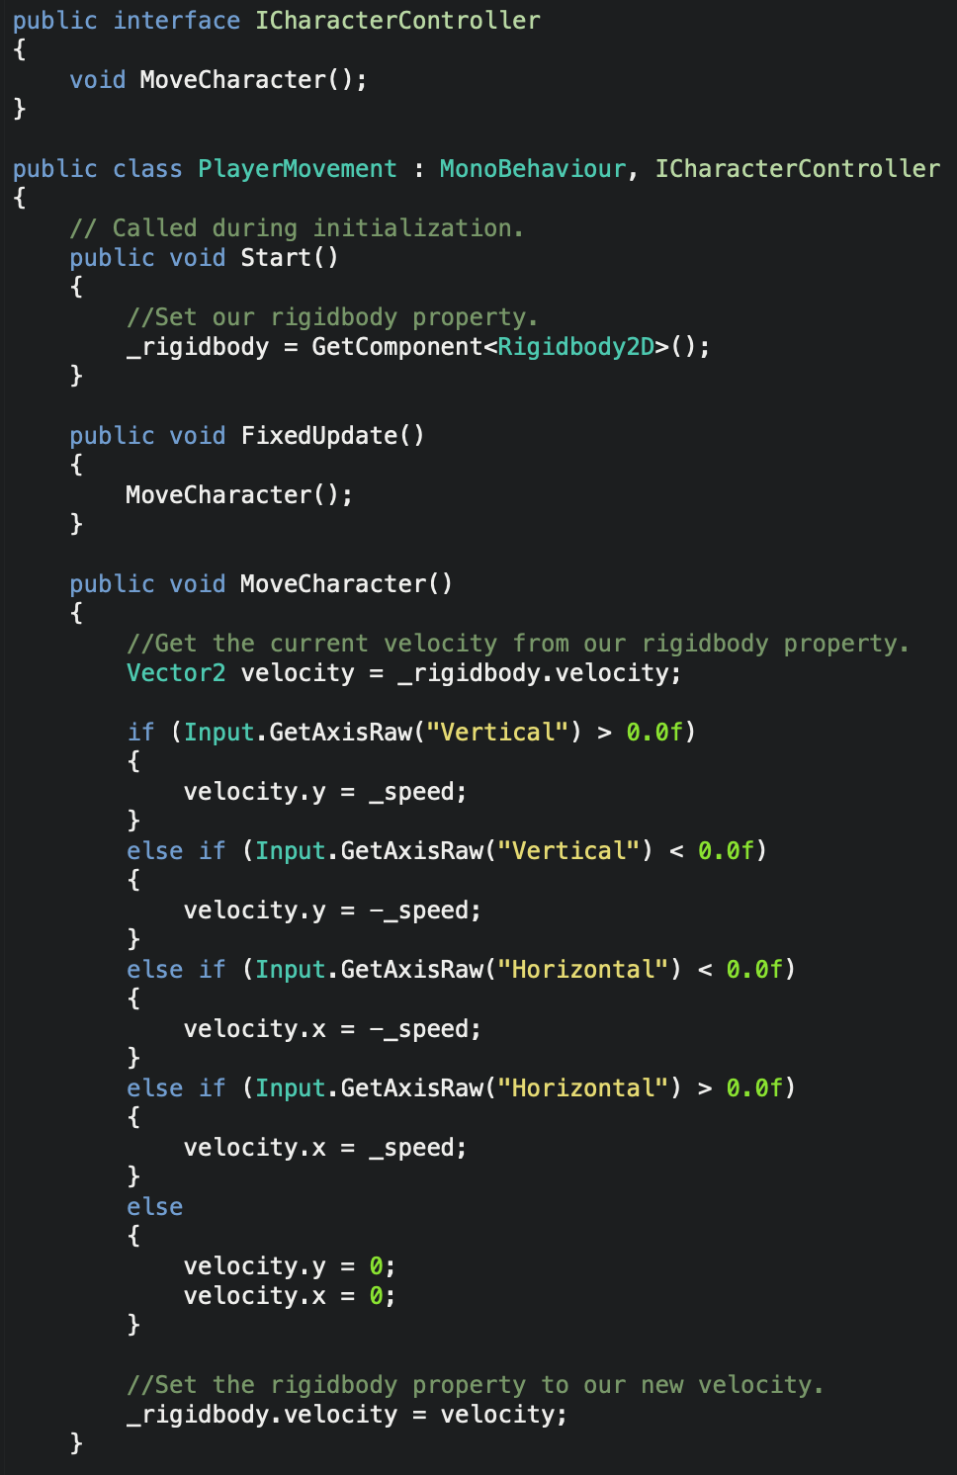
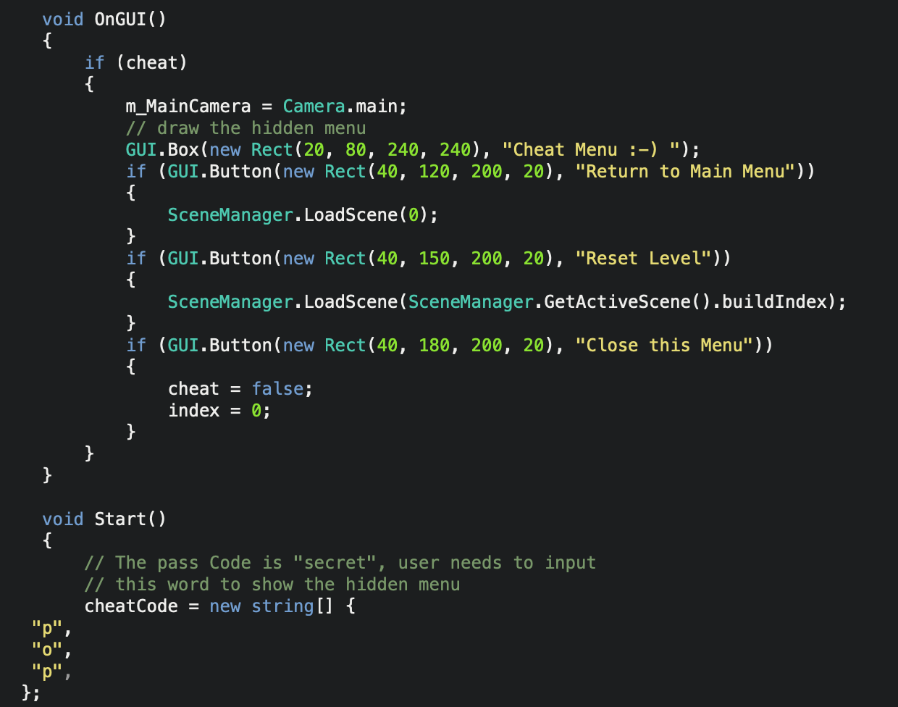
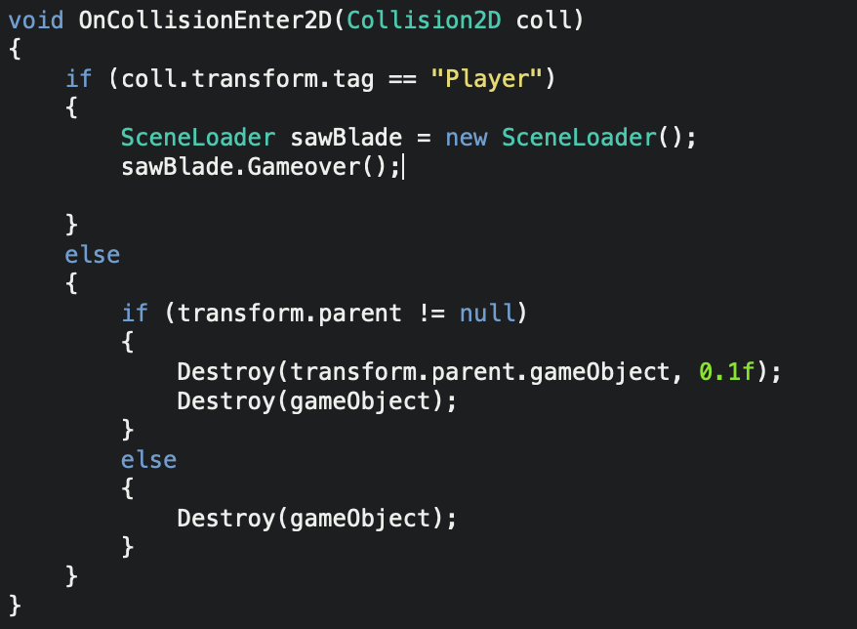
Coding standards continued
Player Movement
Hidden Cheat Menu
Traps

Slide 5
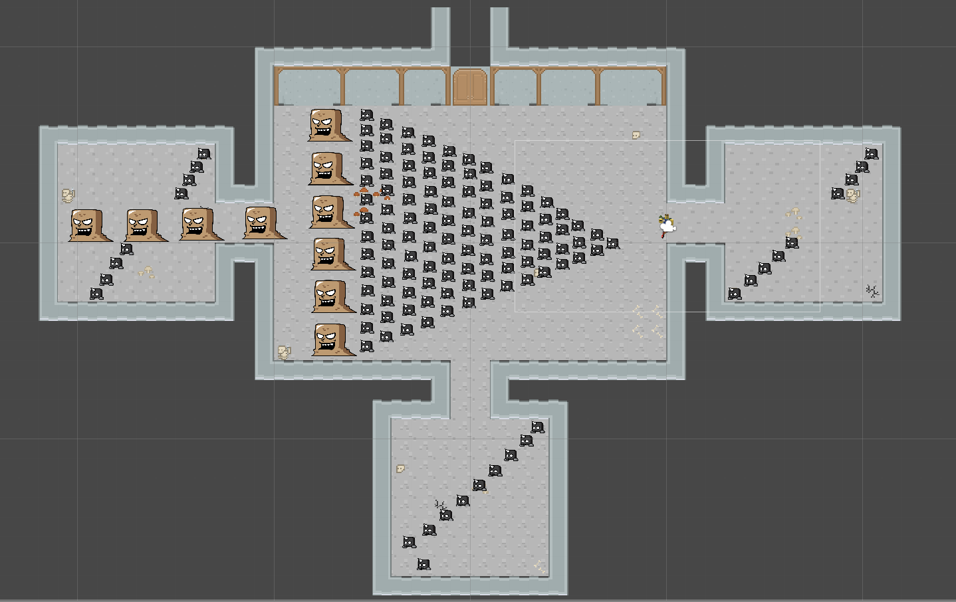
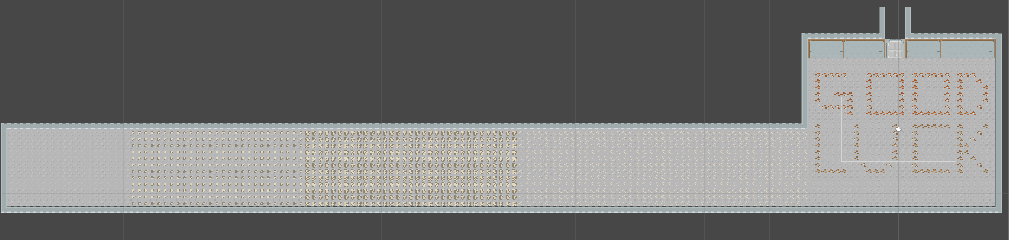
Updates:
Enemy Stress Test
NEW Level 4

Slide 6
Demo

Slide 7
Questions?

